Slide 1
Gary
A Git Collaboration Project
Analysing Crime Data in the West Midlands
Presented by
Shannon Watts
Nathaniel Mweemba
Maxwell Acha
Gary Whitney

Slide 2
Gary
Purpose of the project
To use the west midlands 2019 crime data obtained from West Midlands police, to investigate if the Index of multiple Deprivation (IMD) score had any correlation to the crime rate in the respective area. To determine if certain areas were pre-disposed to higher rates of crime and what else could the IMD score inform us about the crime rates. (break this down into bullet points and if needed)
Research questions
Does the crime data from the West Midlands Police database correlate with the Index of Multiple Deprivation (IMD) score?
Which district and Lower Layer Super Output Areas (LLSOAs) have higher rates of crime?
What type of crime might you be exposed to in certain LLSOAs?
Where is the safest place to park your bike?

Slide 3
Gary
AIMS
To determine any cause and effect of IMD score on crime rate
To interrogate and cross examine the data for the purpose of drawing meaningful conclusions
To determine what relationships exist between IMD score and the crime data
OBJECTIVES
Plot IMD against crime rate and visualize the data
Produce visualizations to determine if certain areas are pre-disposed to higher rates of crime based on IMD score
Plot a heat map to determine areas of high crime
Determine which areas are safest

Slide 4
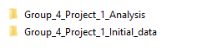
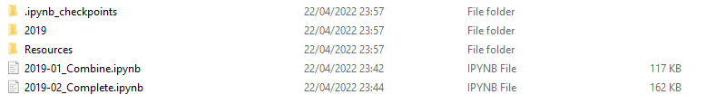
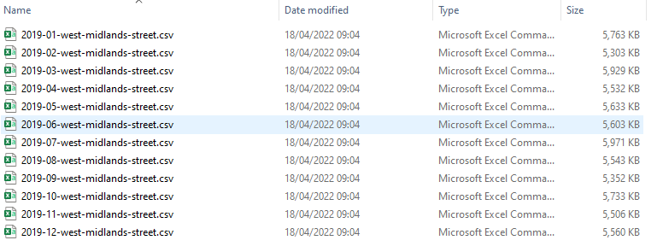

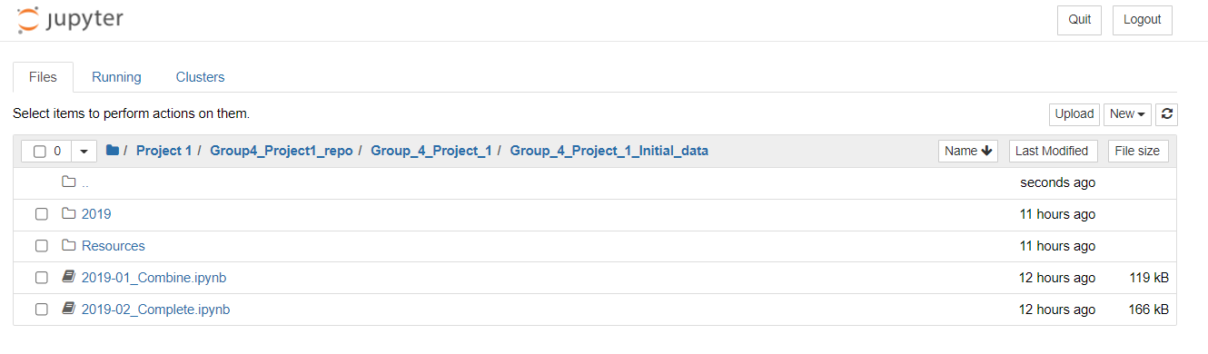
Gary
DATA EXPLORATION AND CLEANSING

Slide 5
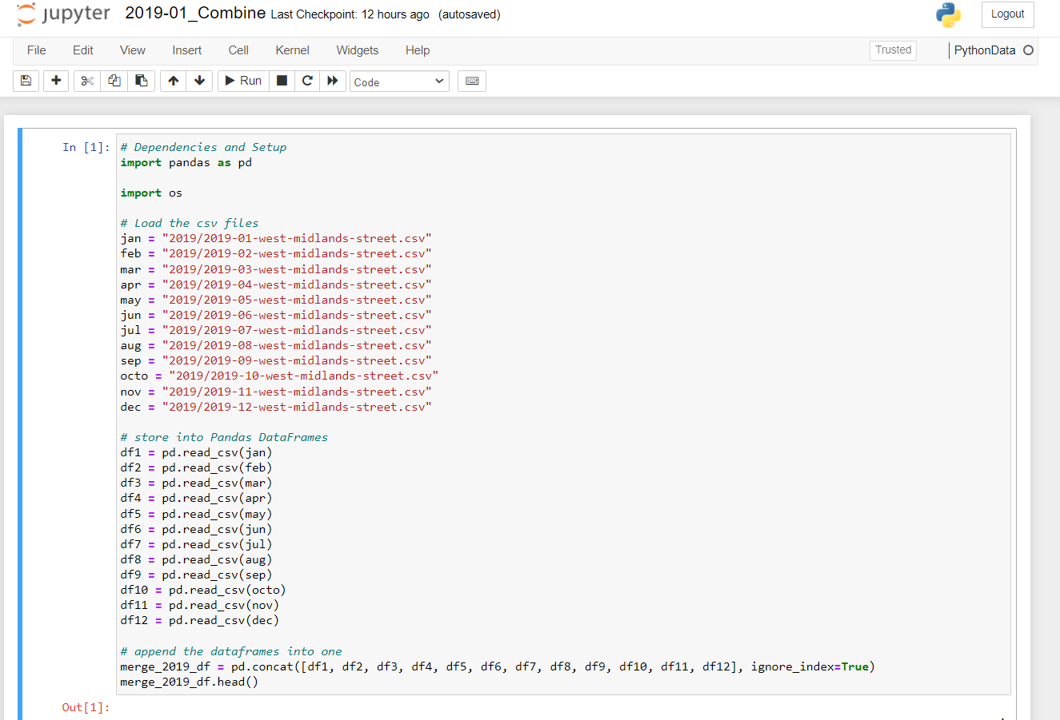
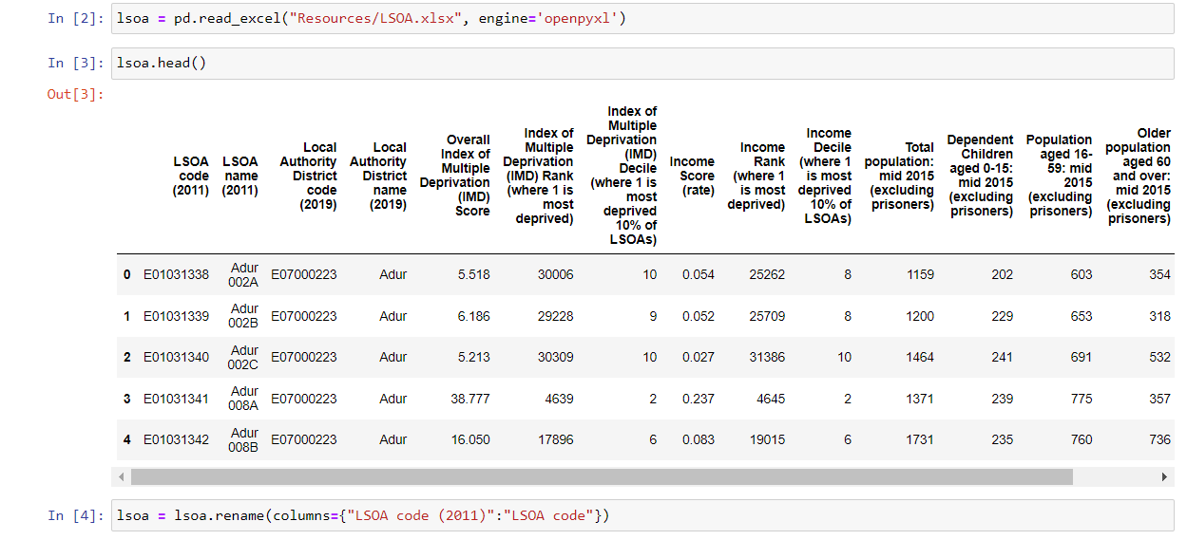
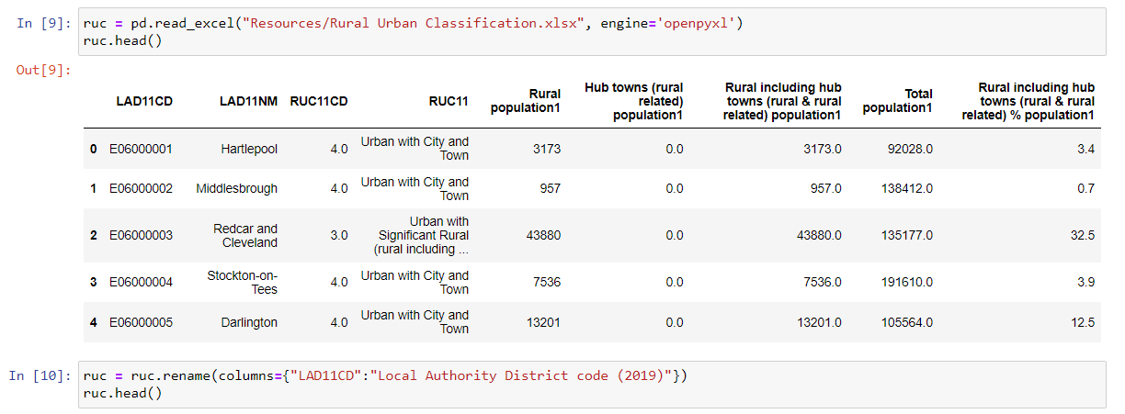
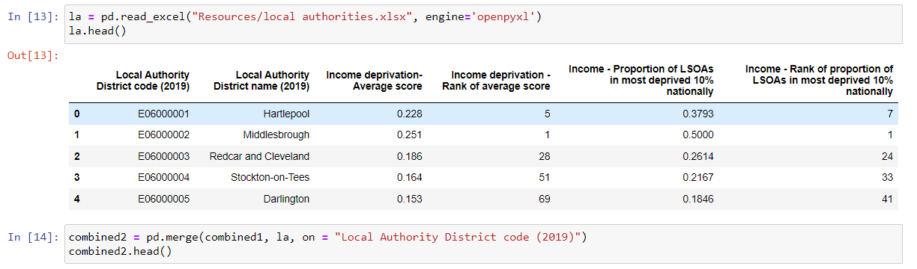
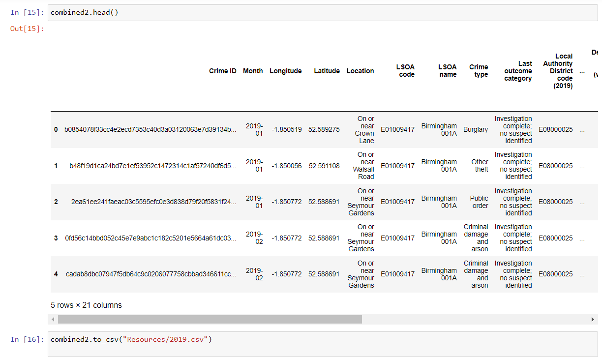
Gary
DATA EXPLORATION AND CLEANSING

Slide 6
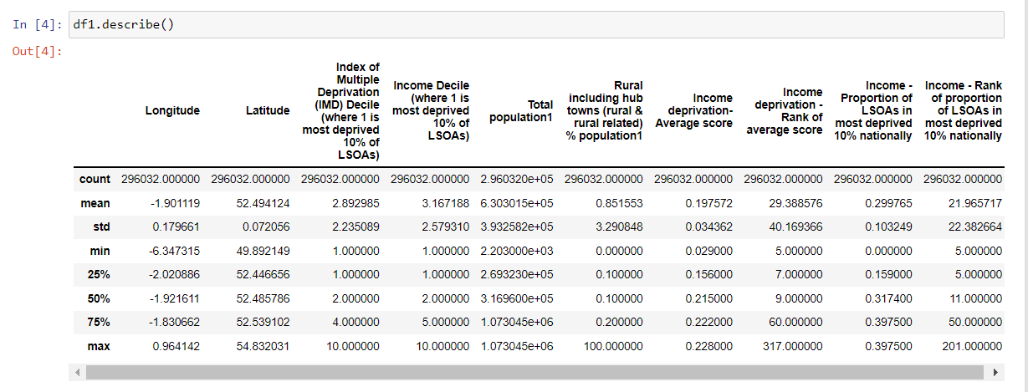
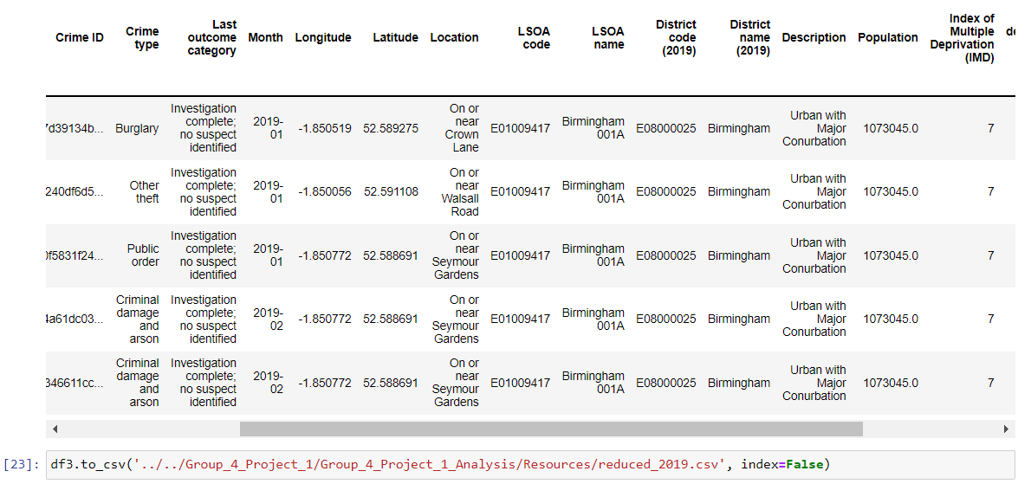
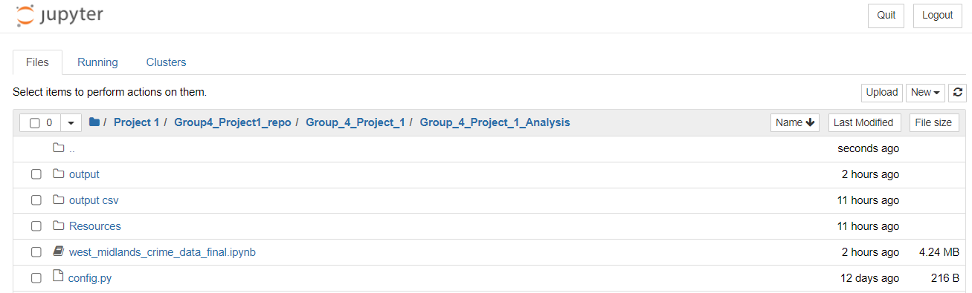
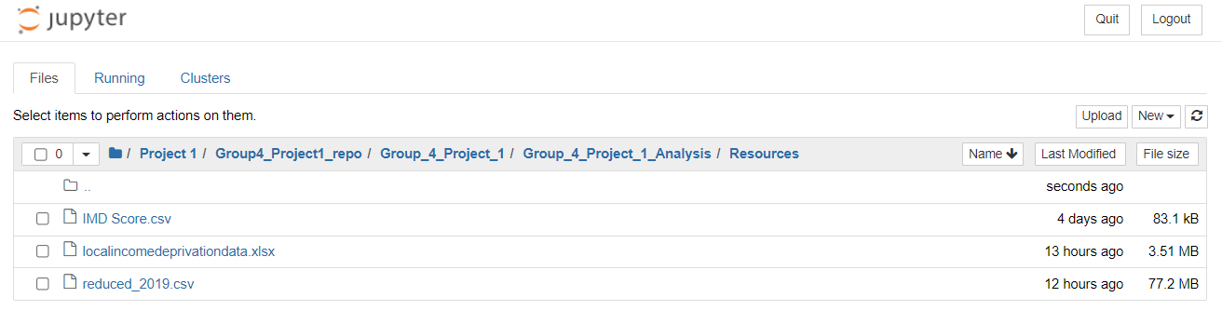
Gary
DATA EXPLORATION AND CLEANSING

Slide 7
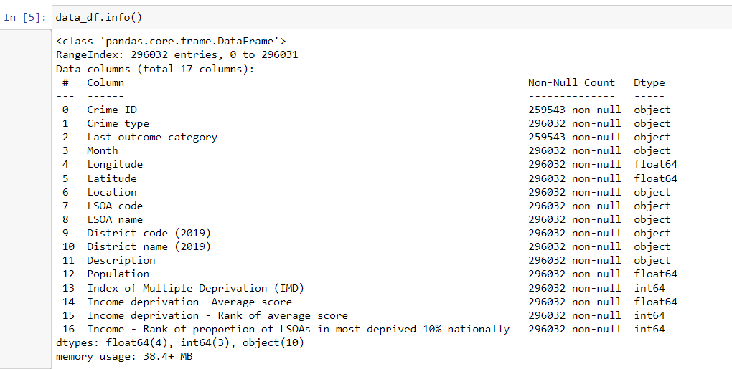
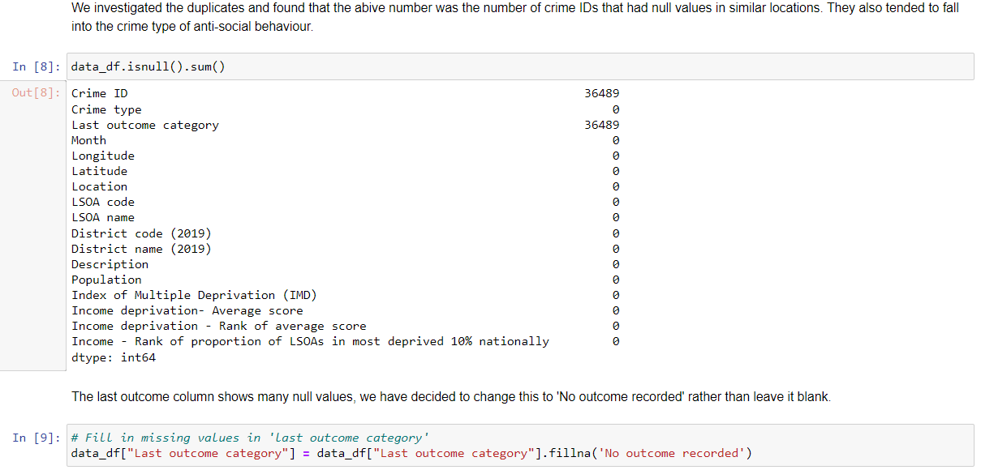
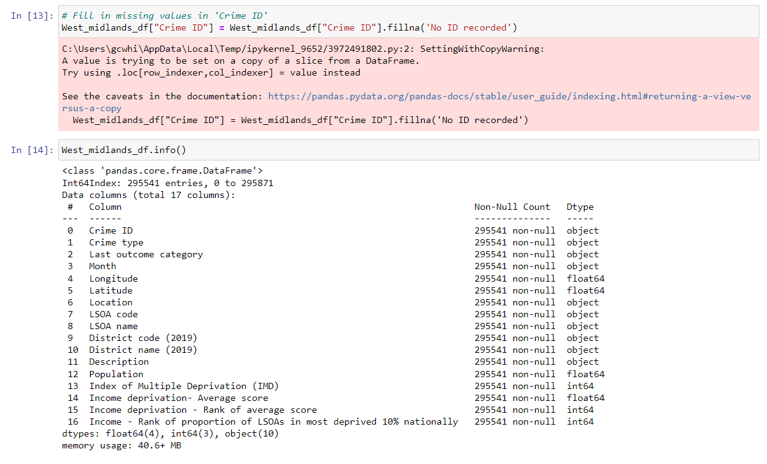
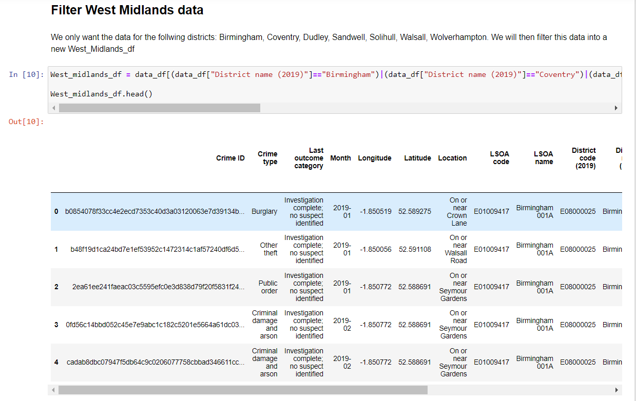
Gary
DATA EXPLORATION AND CLEANSING

Slide 8
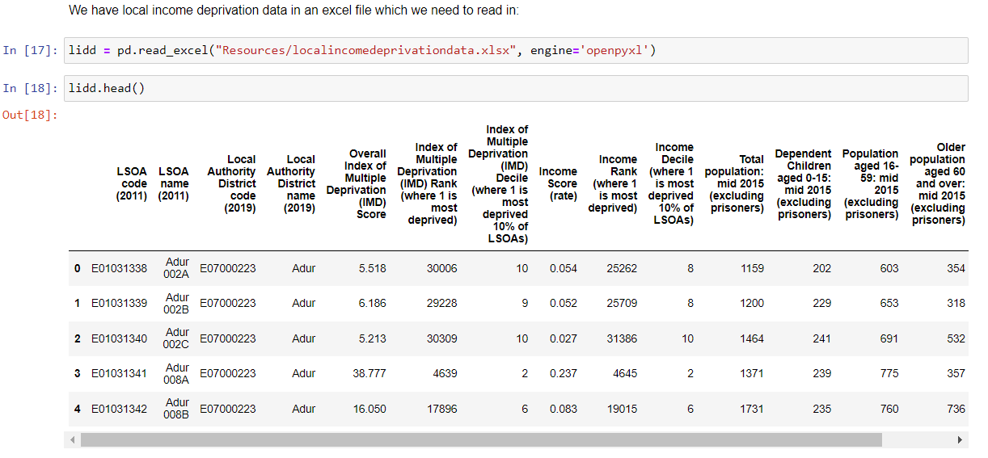
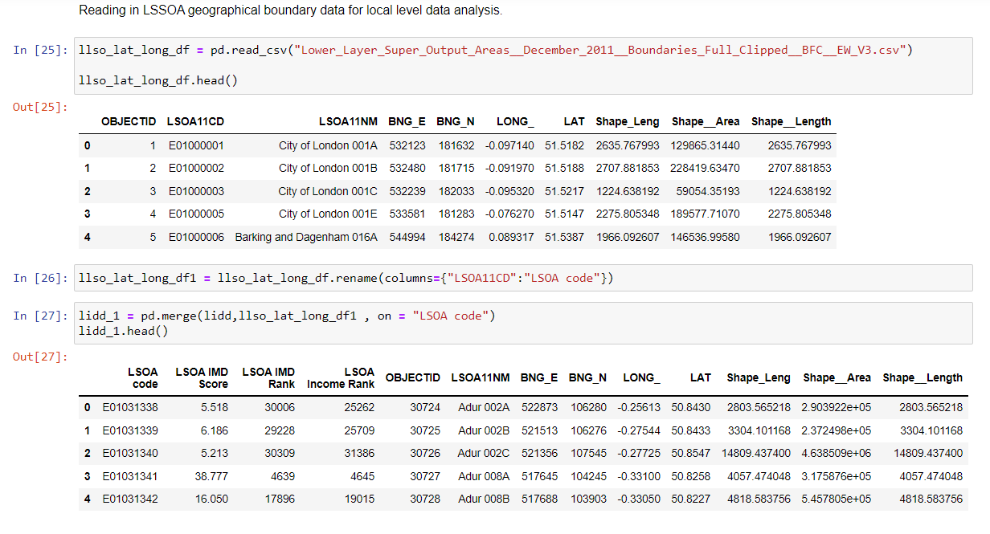
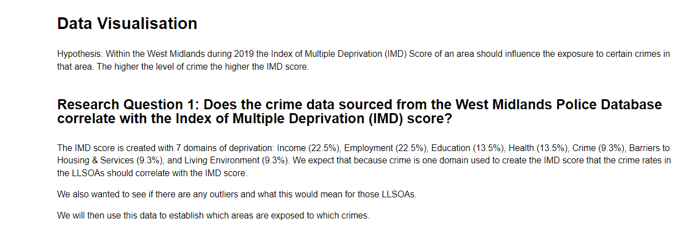
Gary
DATA EXPLORATION AND CLEANSING

Slide 9
Shannon
DATA ANALYSIS PROCESS

Slide 10
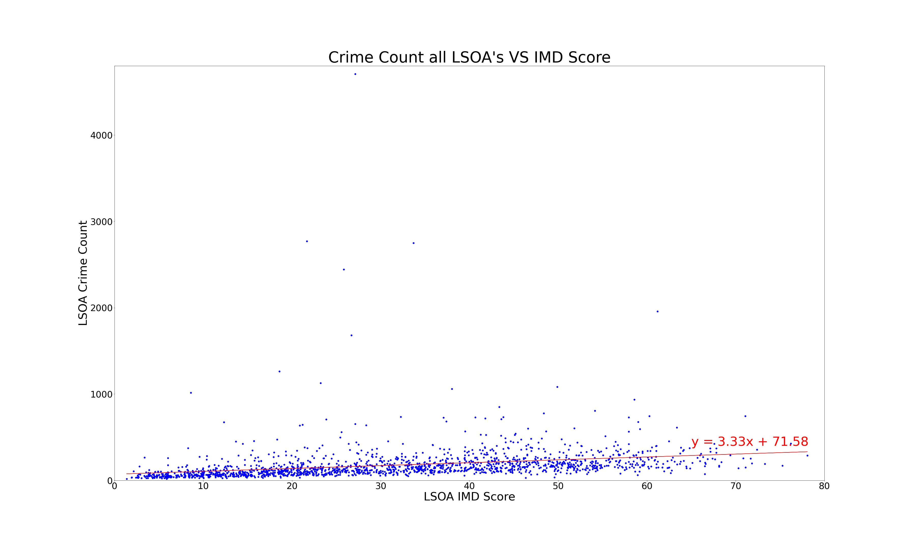
Maxwell
Does the crime data sourced from the West Midlands Police database correlate with the Index of Multiple Deprivation (IMD) score?

Slide 11
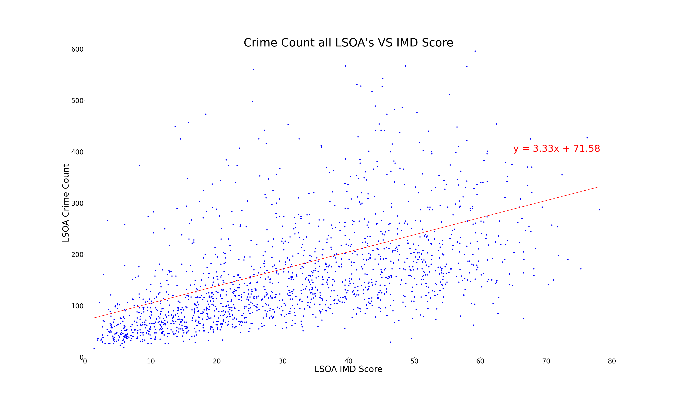
Maxwell
The same plot with the outliers omitted for statistical analysis.
By removing outliers, the y limit was reduced to 600 from over 4000 so that
We could then visualize any correlation and view the linear regression in a higher resolution.
The line of linear regression shows that there is a positive linear correlation, but it is quite weak.
Whilst the amount of crimes increase the higher IMD score is not uniform. There are also high crime rates in LSOAs with low IMD scores.

Slide 12
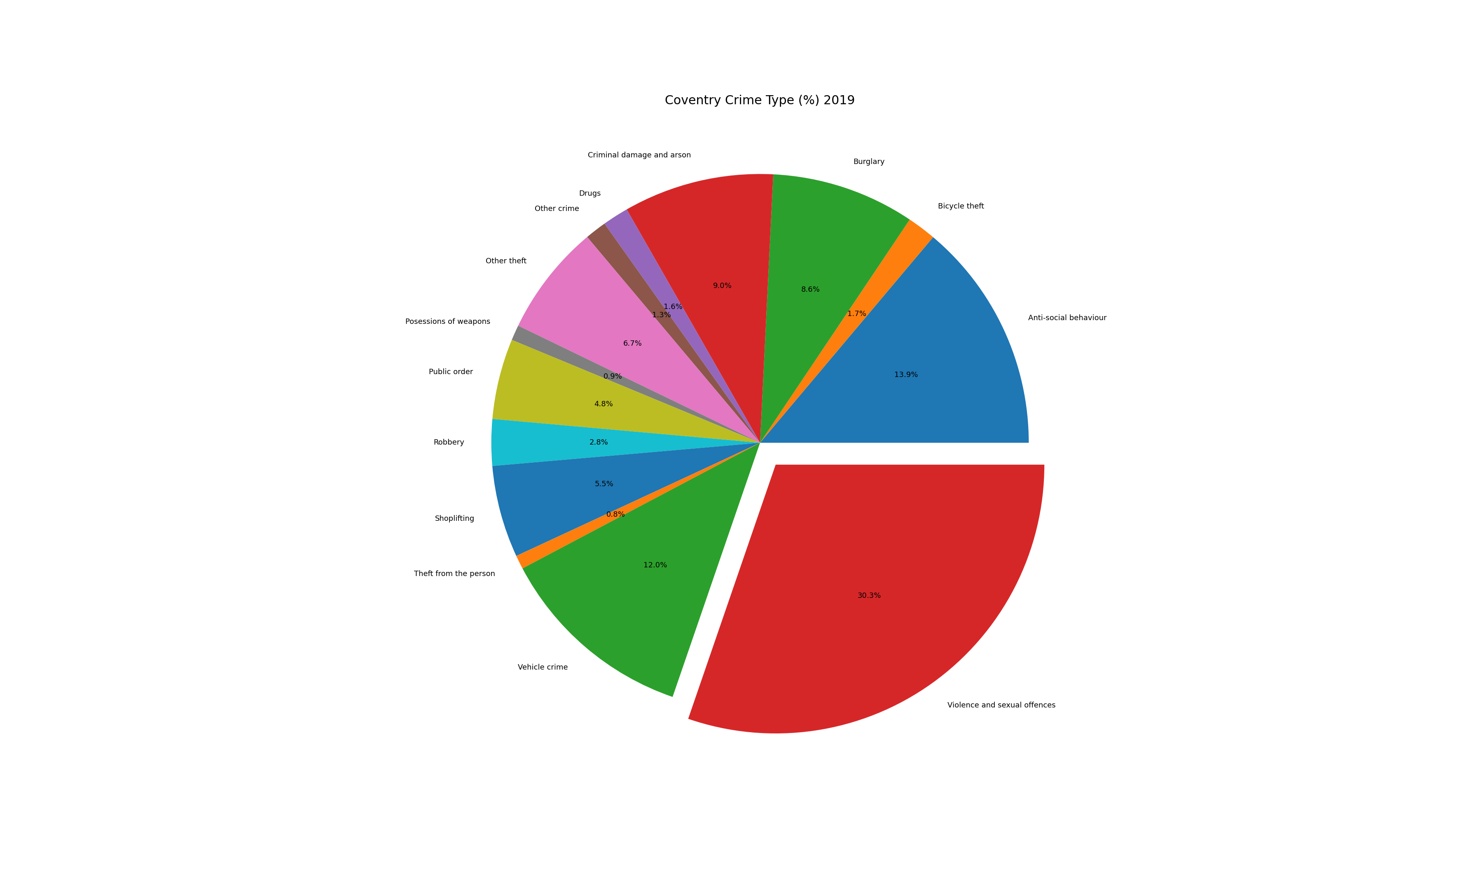
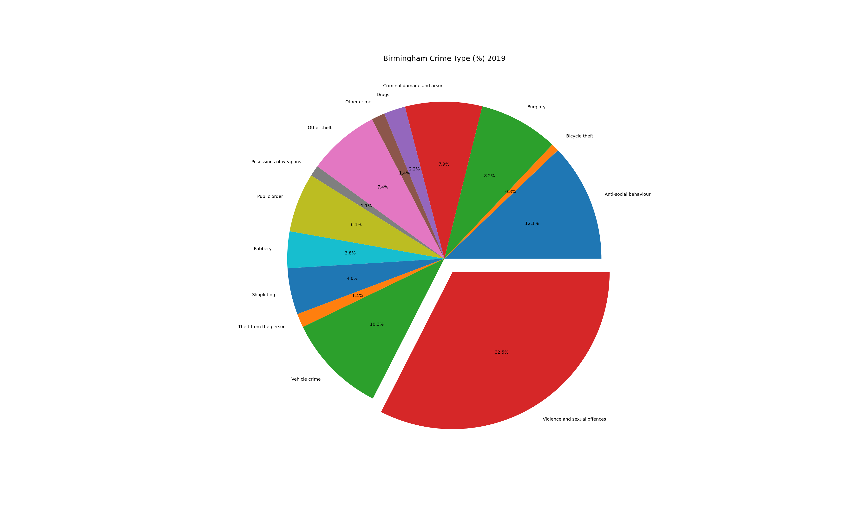
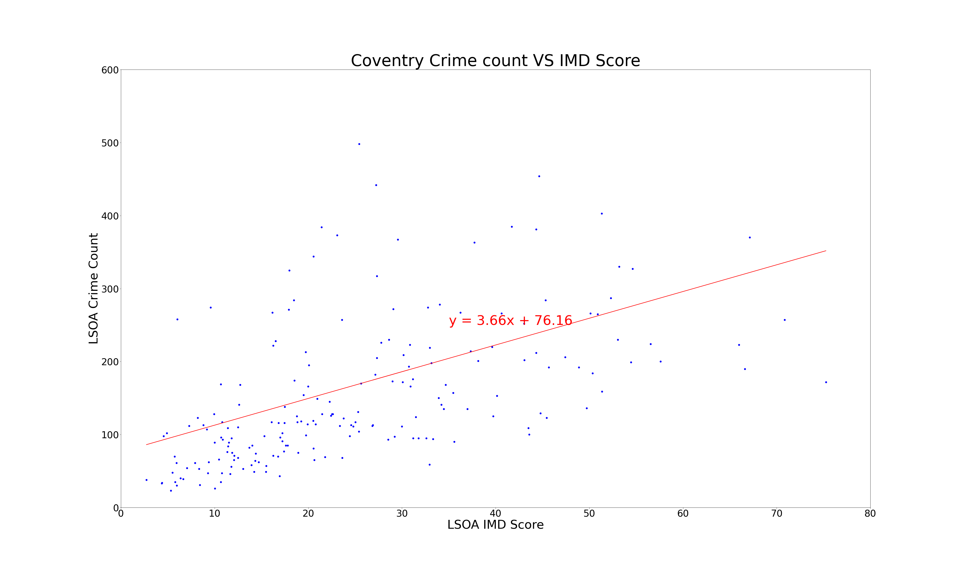
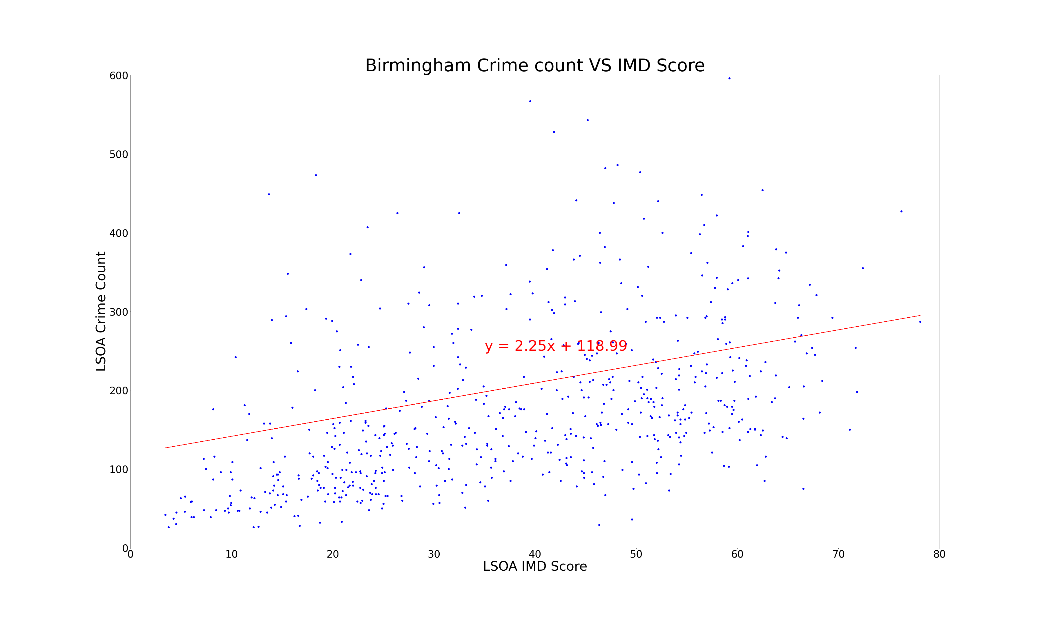
Maxwell

Slide 13
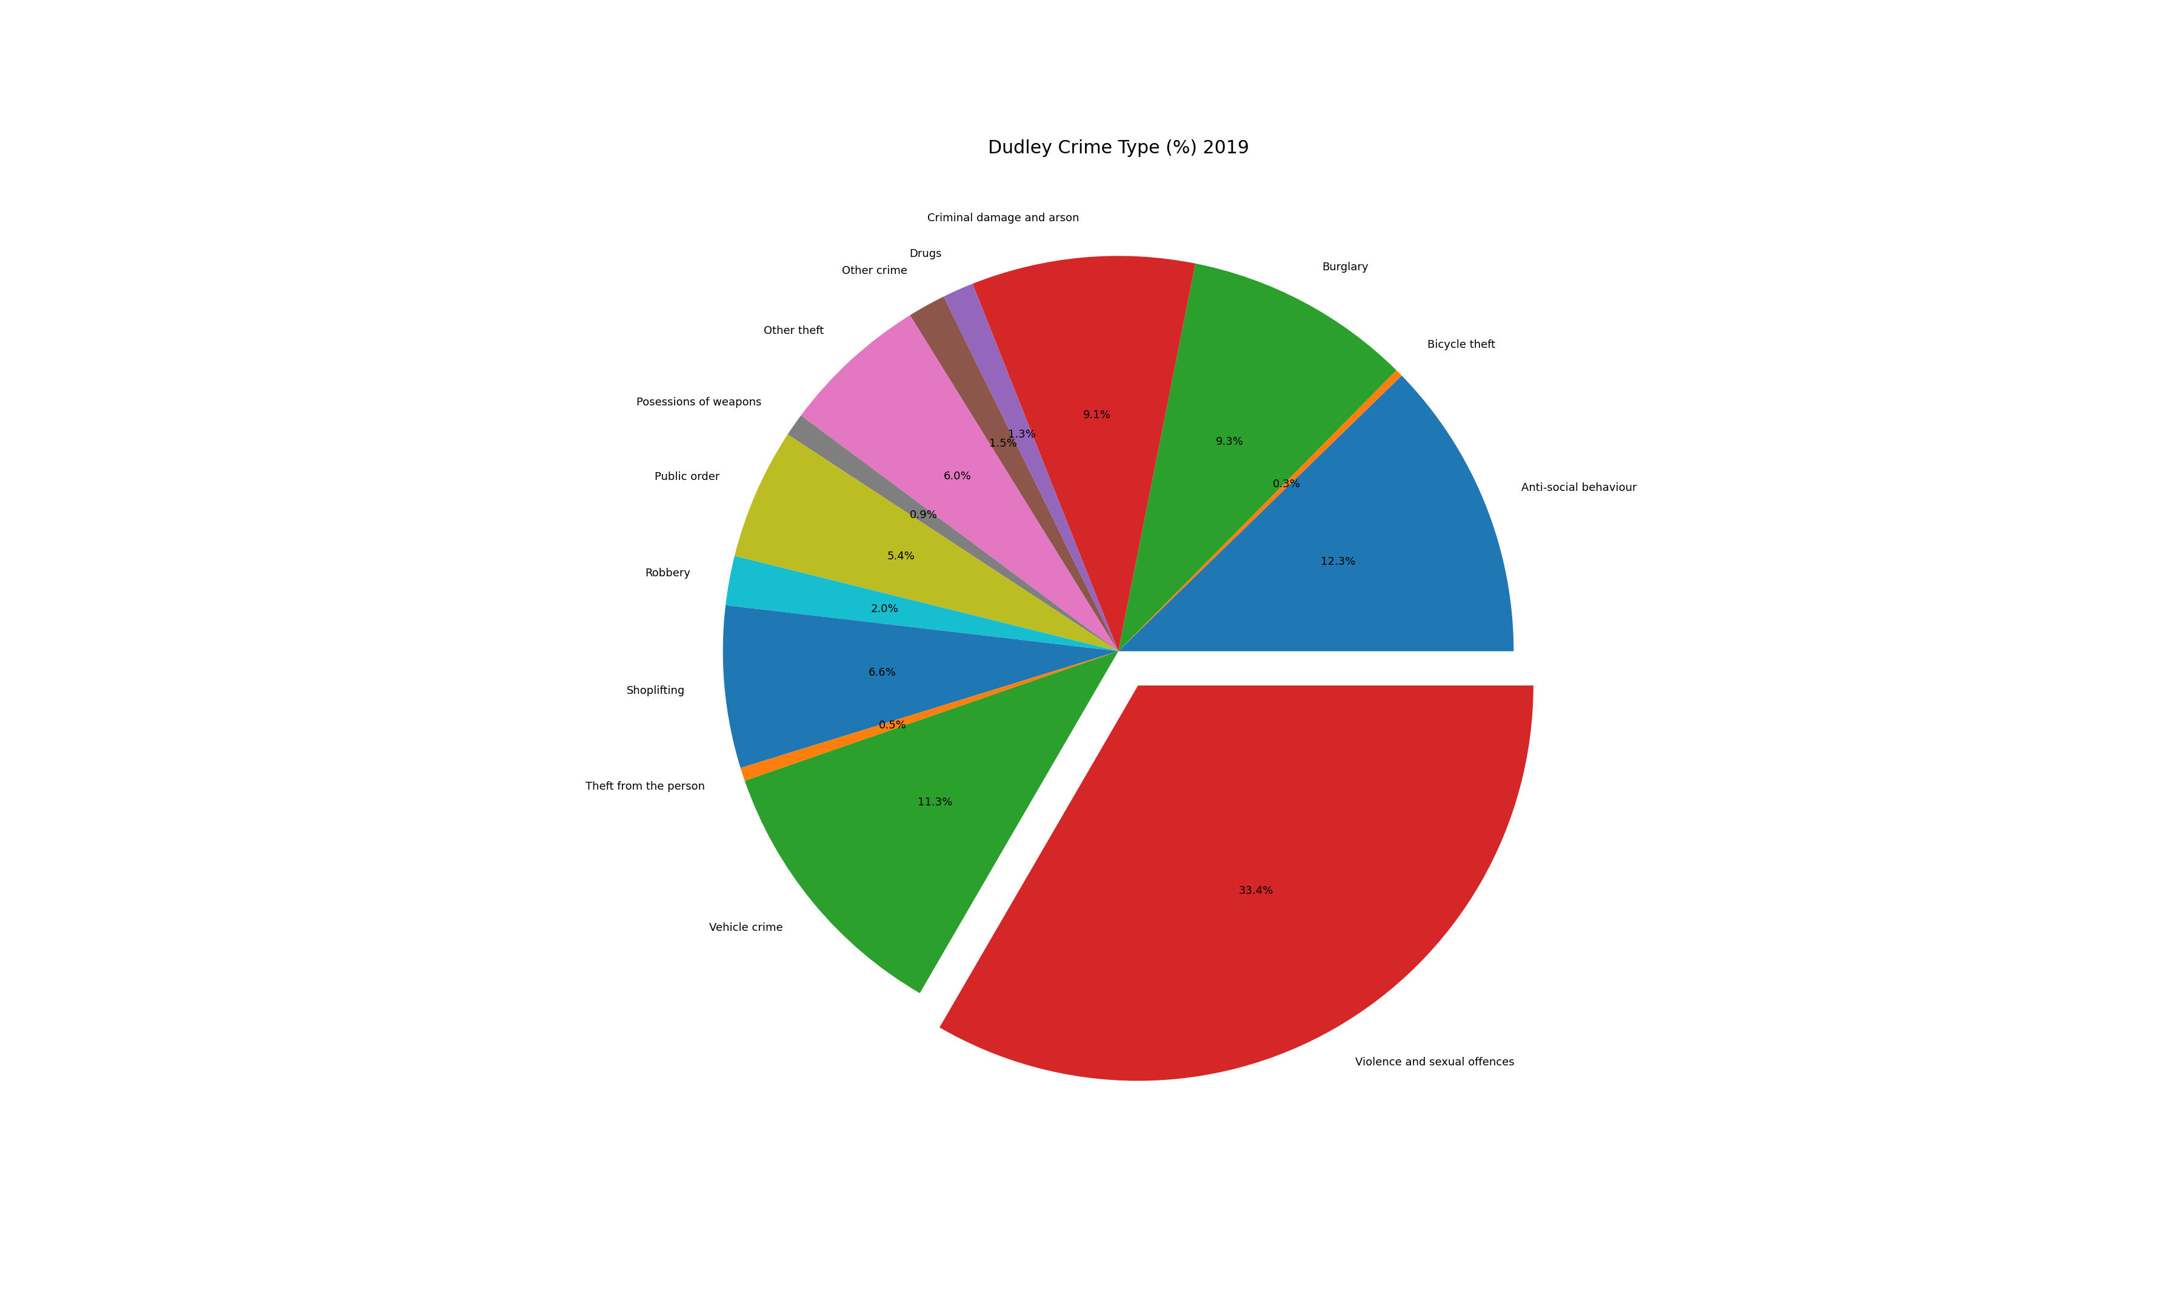

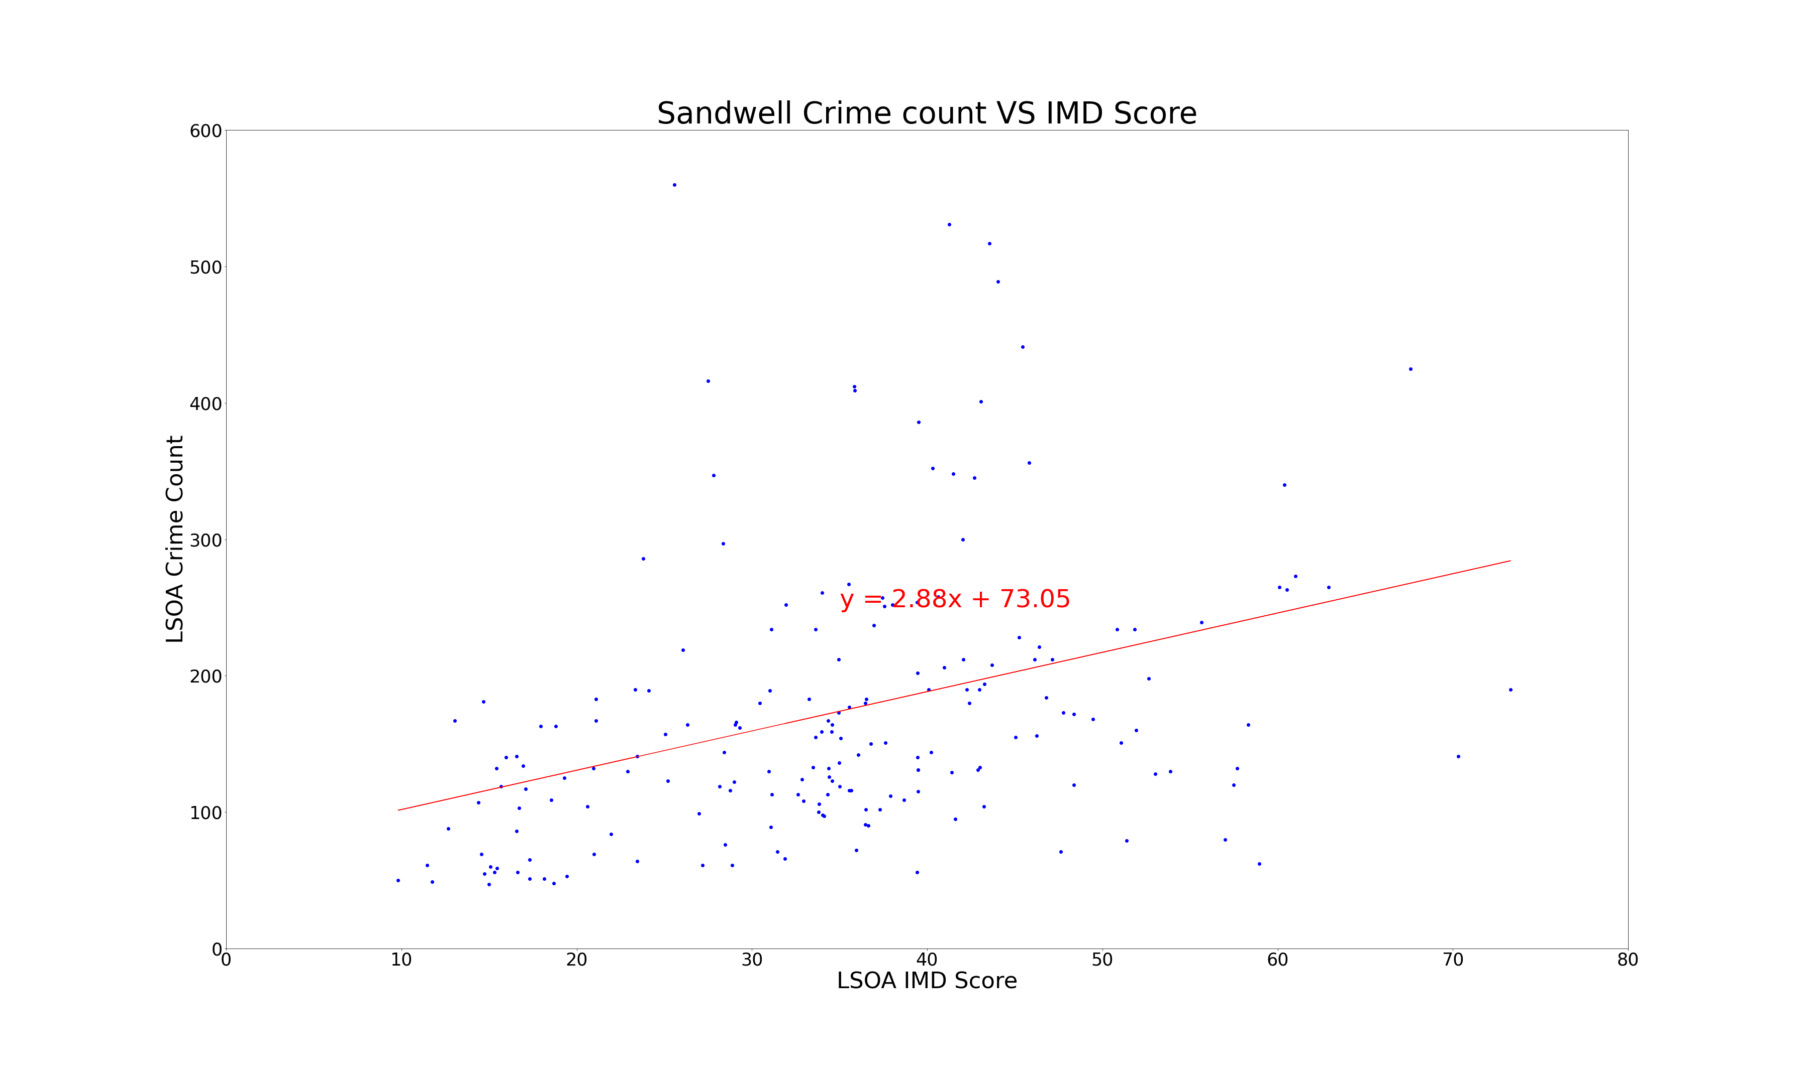
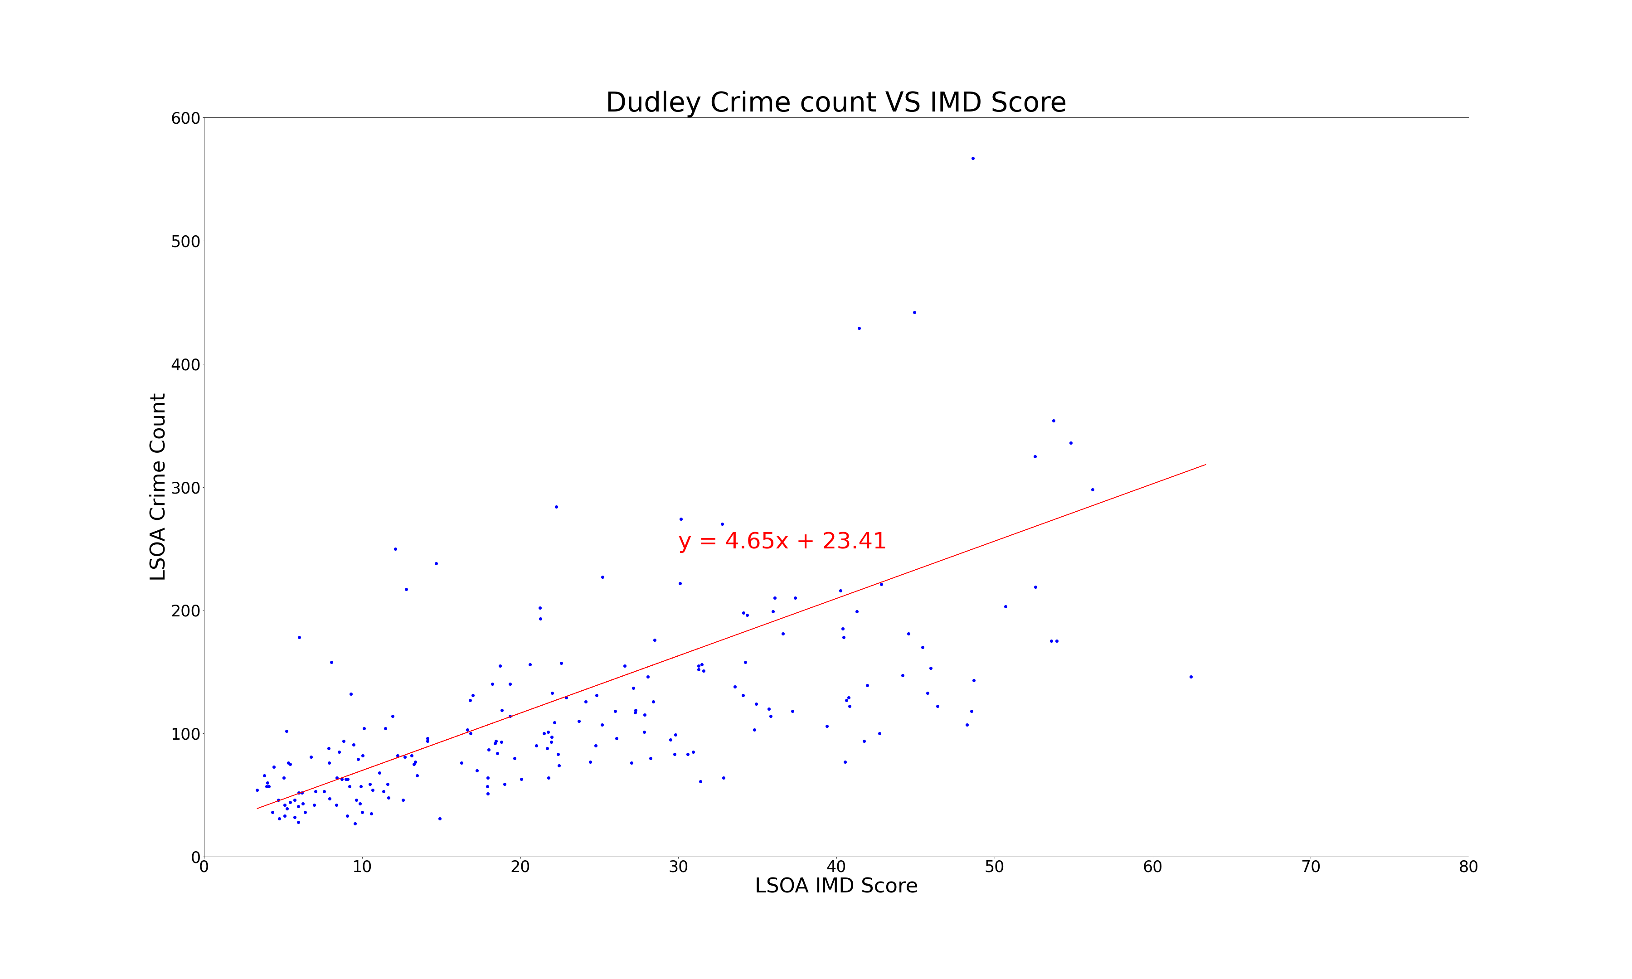
Maxwell

Slide 14
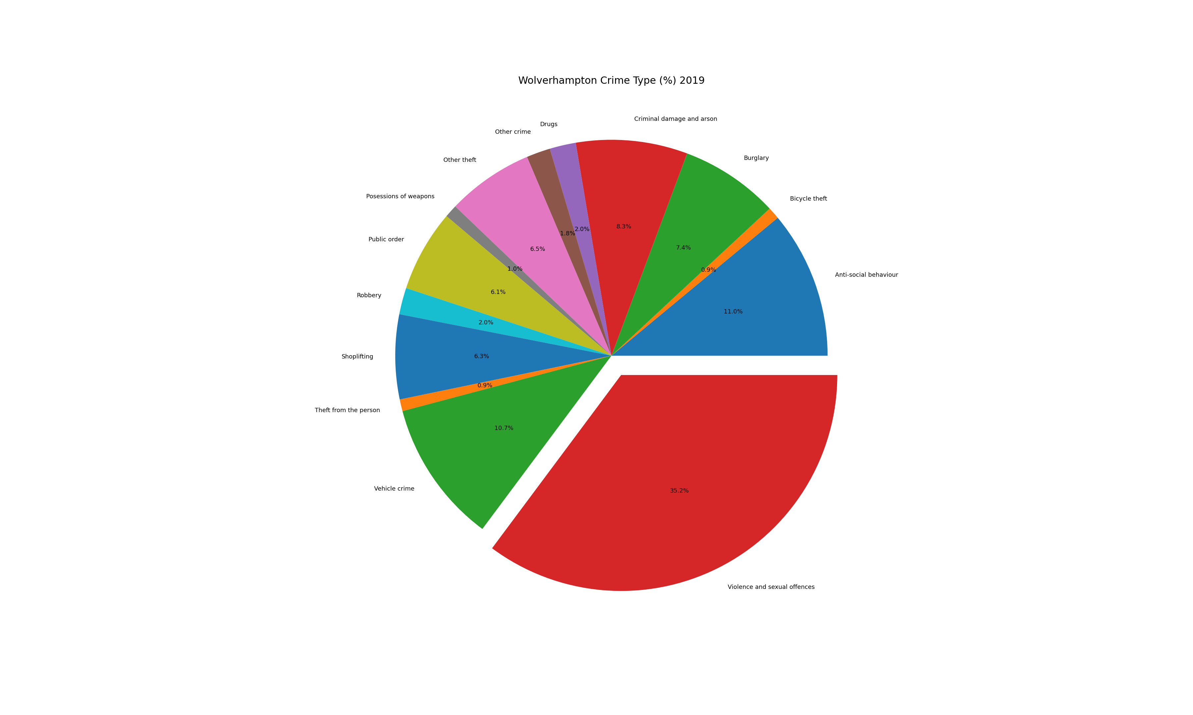
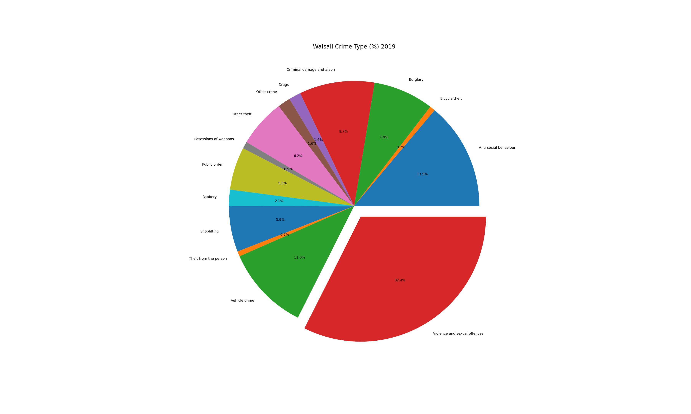
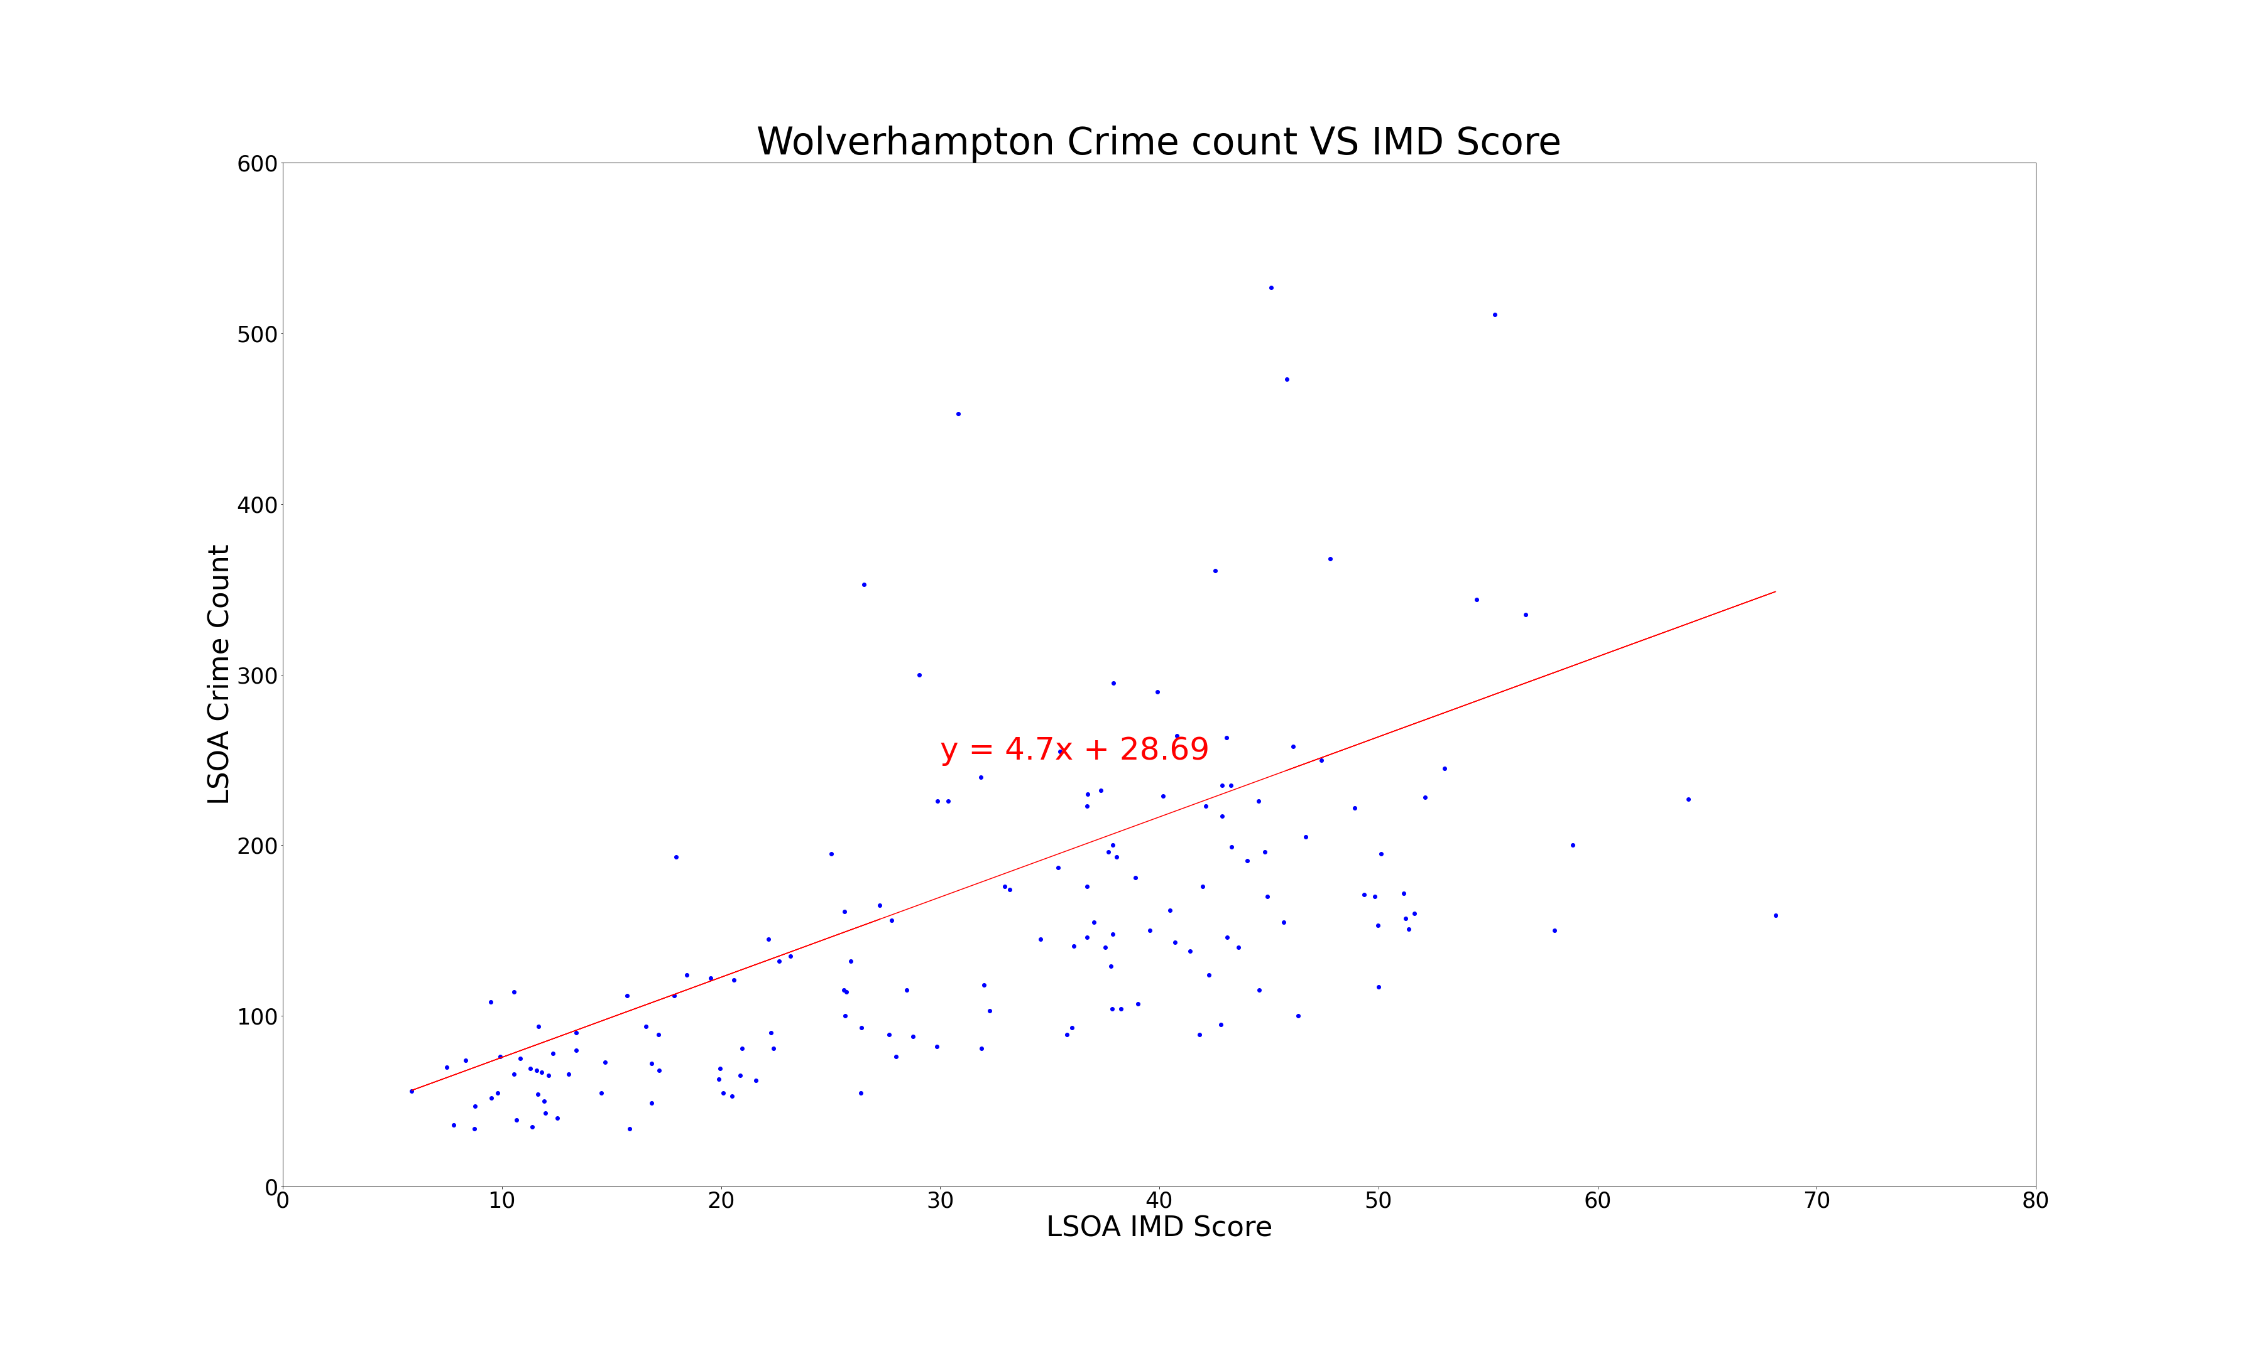
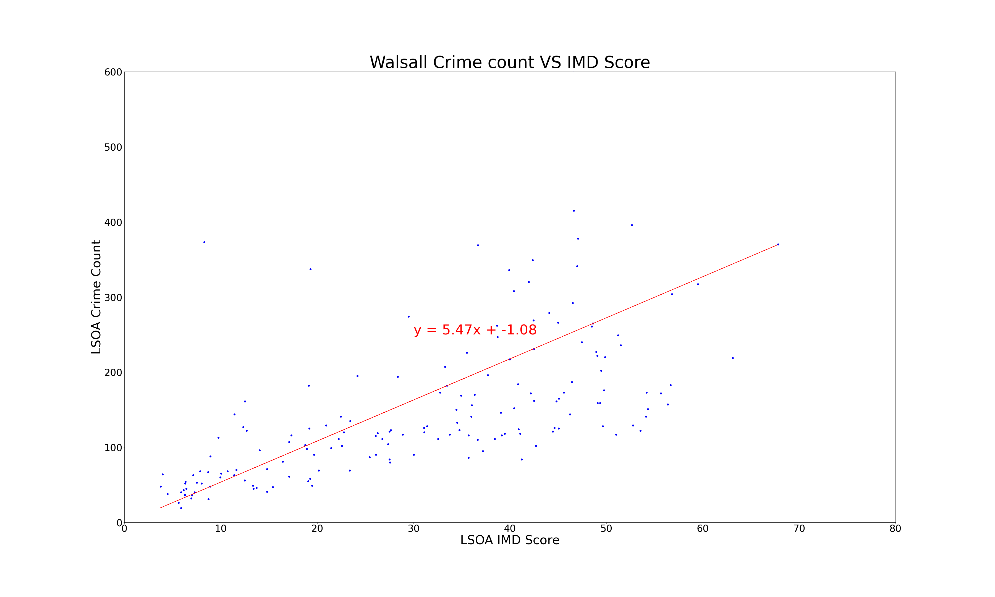
Maxwell

Slide 15
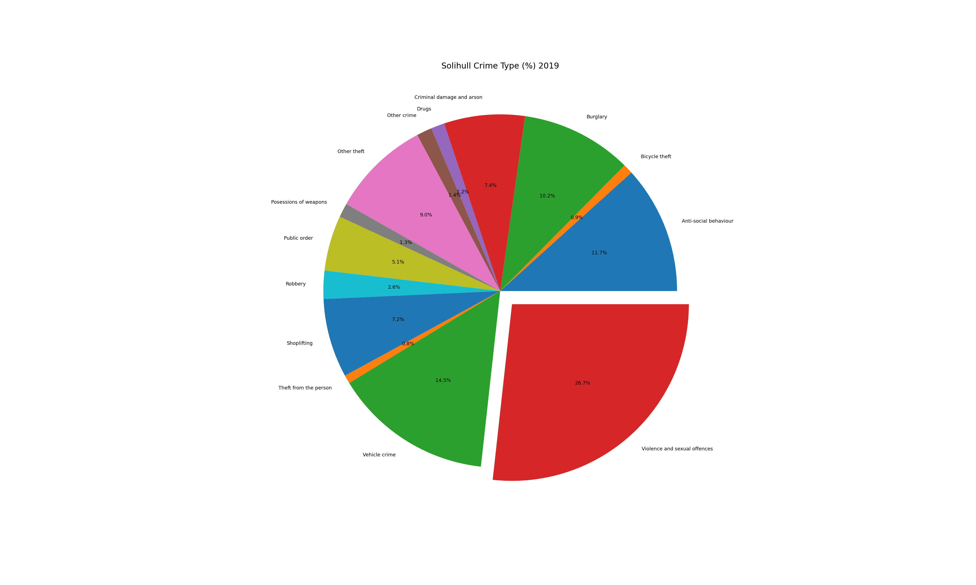
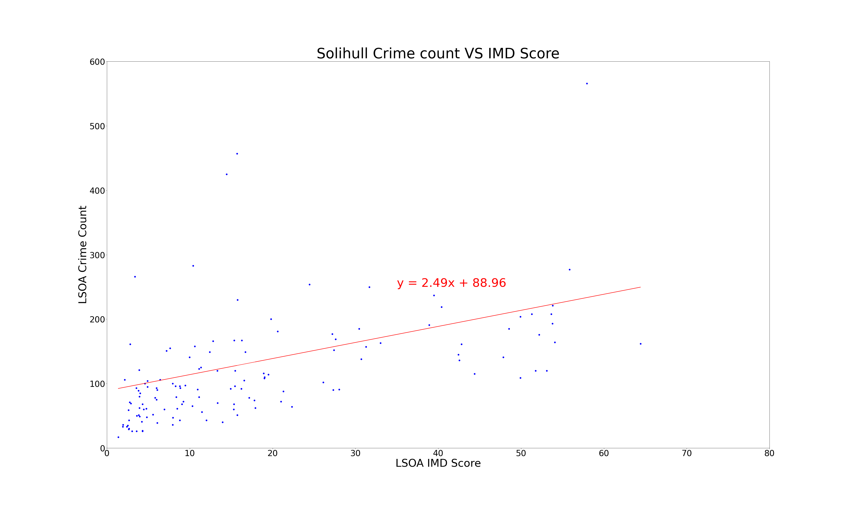
Nathan
Does the crime data sourced from the West Midlands Police database correlate with the Index of Multiple Deprivation (IMD) score?

Slide 16
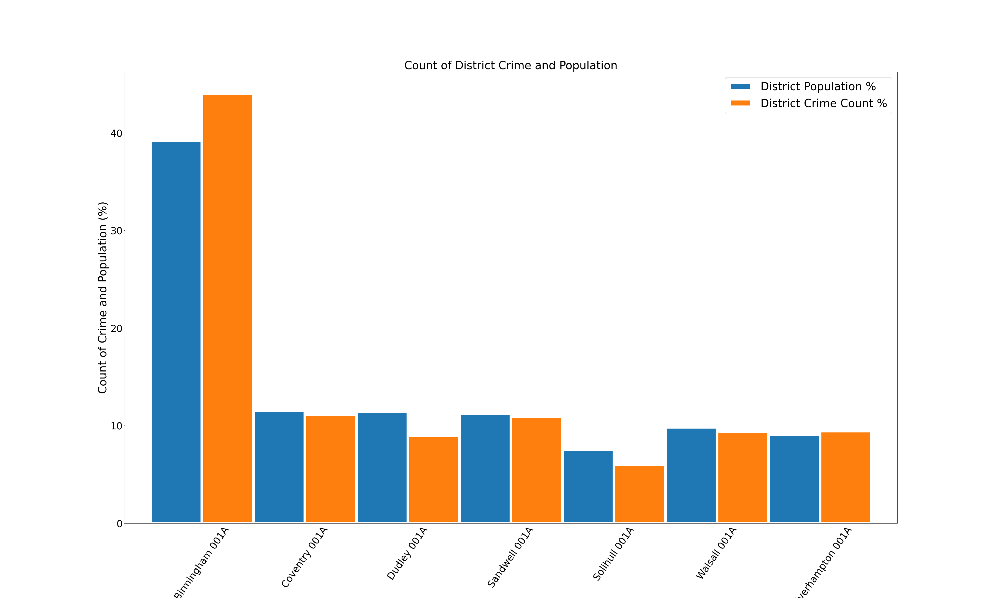
Shannon
Which district and Lower Layer Super Output Areas (LLSOAs) have higher rates of crime?

Slide 17
Shannon

Slide 18
What type of crime might you be exposed to in certain LLSOAs?
Shannon

Slide 19
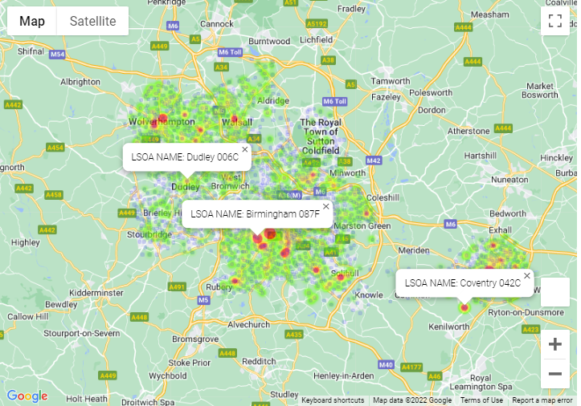
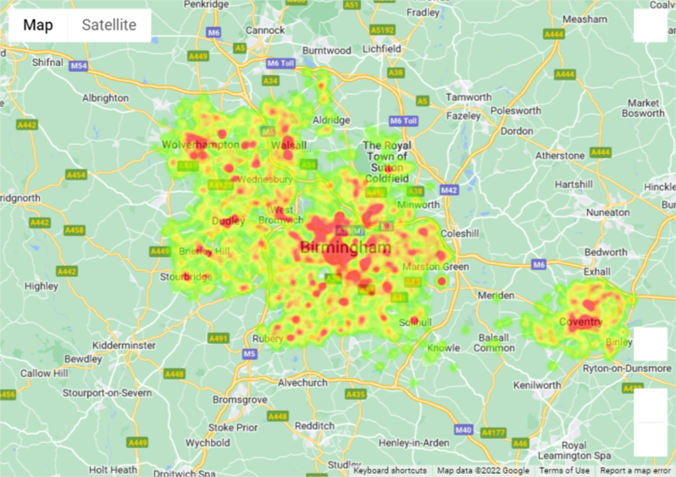
Gary
Where is the safest place to park your bike?
Crimes are focused on the city centers and when you look specifically at bike thefts the story is similar with some notable exceptions.
There appears to be a lot of bike thefts in areas around Universities, especially Warwick & Birmingham University and notably less bike thefts in Dudley!
Distribution of all bike thefts across the West Midlands in 2019
Distribution of all crimes across the West Midlands in 2019

Slide 20
Maxwell / Nathan
2019 Crime Survey for the West Midlands
CONCLUSIONS
There is a weak positive correlation between LSOA Index of Multiple Deprivation score and crime count. Walsall has the strongest positive correlation, and this supports our hypothesis. The other districts do not tend to have a signifcantly maority of LSOAs that have crime counts higher than 300. Sandwell had the weakest linear correlation with higher counts of crime in all LSOAs. This highlights that not all areas with a high deprivation score have high crime counts, and vice versa, the areas with lower deprivation levels still see high levels of crime.
A lower IMD score does not mean that there will be less crime and a higher IMD score does not mean that there will be a higher crime rate.
There are higher crime rates nearer the city centers, by universities, and near hospitals.
Each district in the West Midlands has a similar crime trend. Violent and sexual offences make up the largest proportion of crime for all districts. And the other types of crime also follow similar patterns.
Depending on which district and LSOA you are in you will witness different crimes, e.g. In Solihull you are more likely to witness vehicle crime or theft, whereas in Wolverhampton there are more violent offences.
Wolverhampton has the highest rate of violent and sexual offences in the West Midlands.
Burglary, Shoplifting, Criminal damage and arson is higher in LSOAs with lower IMD scores. Vehicle crime is massively higher in in LSOAs with lower IMD scores. However, Theft from person and public order crime is much lower than LSOAs with higher IMD scores.

Slide 21
All
Q&A

